Slide 1
Typing Data
STAT-702 Project
By
Dheeman,Monica,Quinn

Slide 2
TABLE OF CONTENTS:
The problem
Introduction
FlowChart
Data Cleaning
Descriptive Statistics
Splits
Methods
Models
Predictions
Results
Conclusion
References

Slide 3
The Problem
Group of 51 individuals who have access to a passcode for a specific system.
When an individual has access to the system, no other individual can have access to the specific system.
While an individual has access to the system they will be prompted to enter the passcode at various intervals.

Slide 4
INTRODUCTION
We are provided with two datasets:
Known.csv which has the information the times when an individual in a given session is known.
Unknown.csv in which the individual in a given session of time is unknown who is assumed to be one of the 51 individuals with access to the passcode.

Slide 5
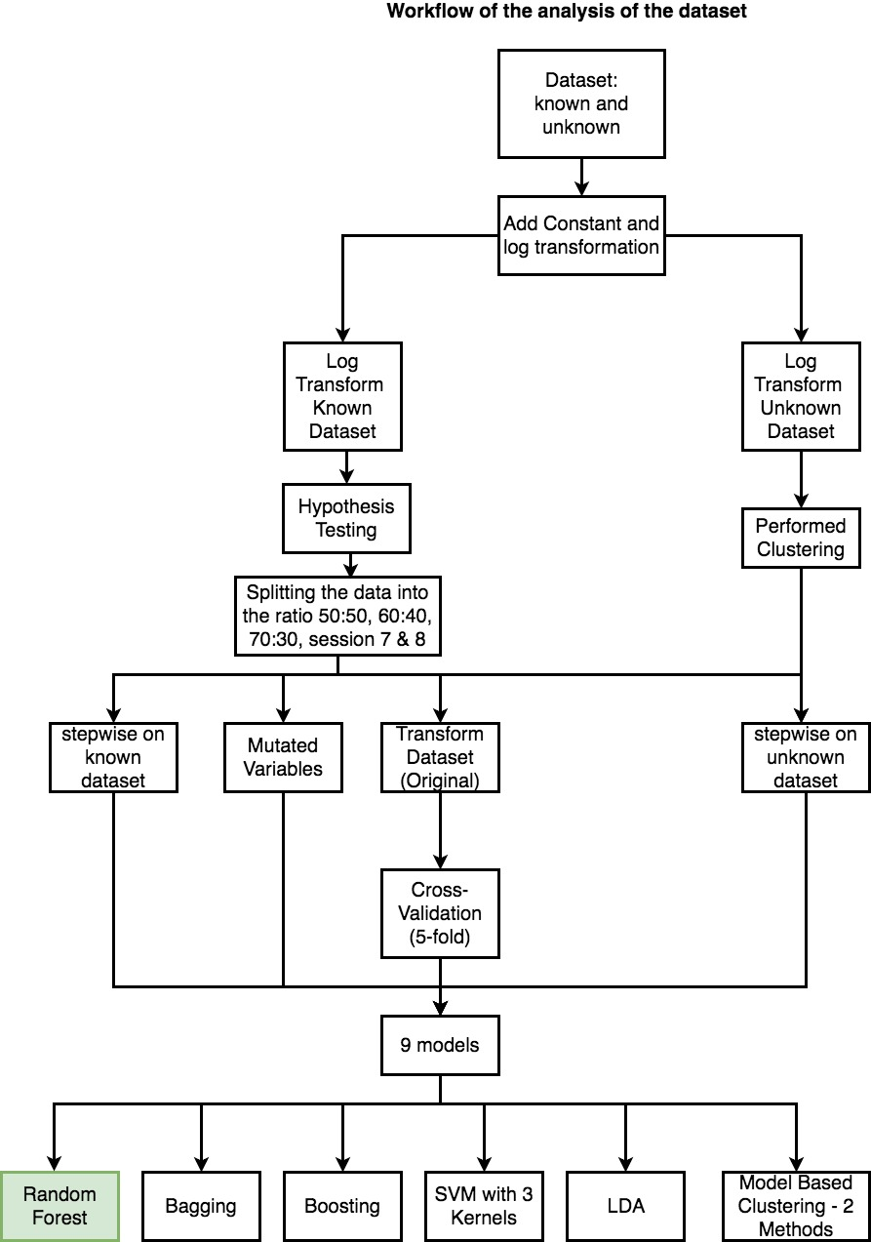
Flowchart of the Dataset Evaluation

Slide 6
Data Cleaning
We normalized the data
Added a constant to the predictors then log transform the data
Excluded the subject, sessionIndex and rep variables

Slide 7
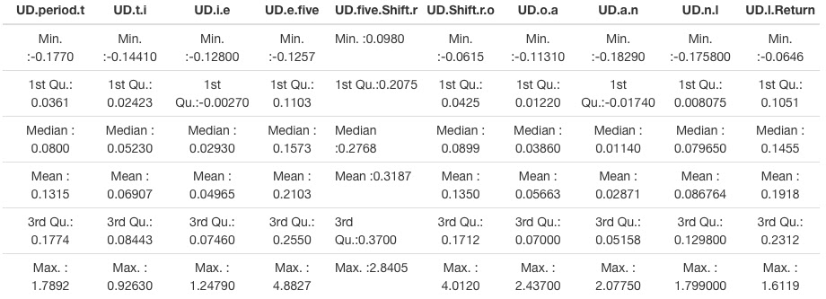
Negative Values

Slide 8
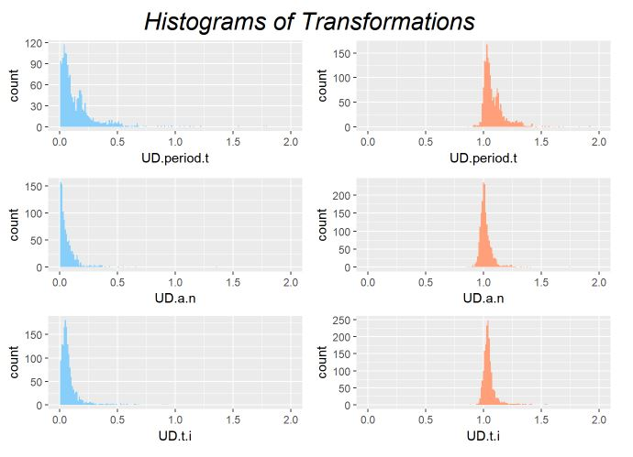
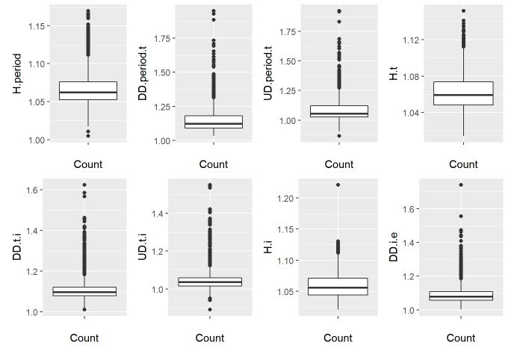
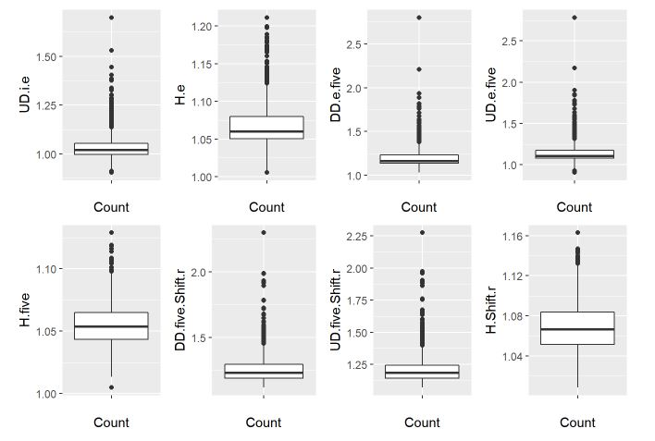
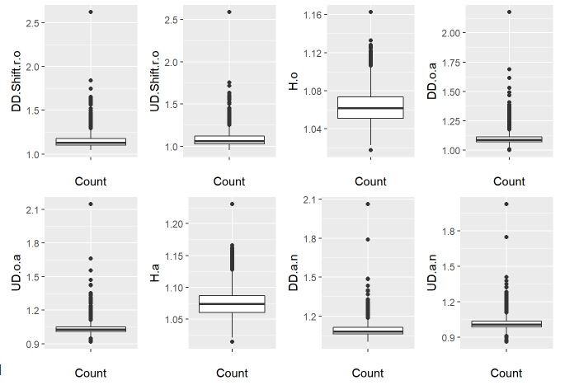
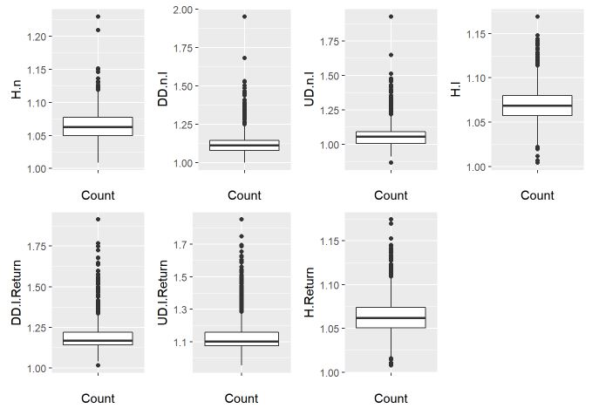
Descriptive Statistics

Slide 9
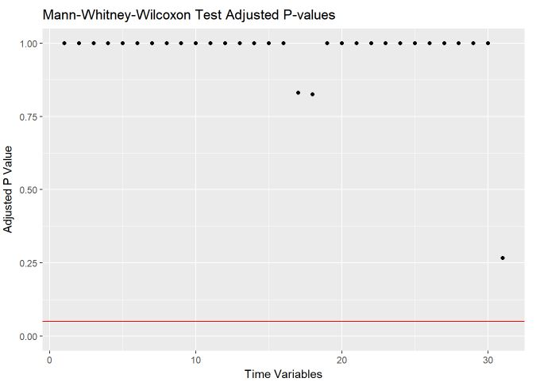
Known Session Indepencence
Notes:
This Slide Has an issue

Slide 10
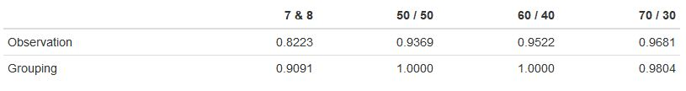
Training / Testing Splits
We have tried three different splits with validation set approach including 50:50, 60:40 and 70:30.
We have also used k-fold cross validation for the model with highest accuracy.

Slide 11
Methods
We tried 5 different approaches:
The original dataset with log transformation
Variable Selection in known dataset
Variable selection in unknown dataset
Mutated Variables
PCA Variables

Slide 12
Mutate Variable Creation
We used this approach based on a paper that we found.
In this approach they used the standard approach of the keyboard setup, where the hand position of the QWERTY keyboard was used to setup the new features.
List of variables we created:
Leftpointer = H.Shift.r + H.t + H.five
Rightring = H.i + H.o + H.l + H.period
Lefthand = H.Shirf.r + H.t + H.five + H.a
Righthand = H.period + H.i + H.o + H.n + H.l + H.return
Total = sum of all of the time variables except (H.e,DD.e.five,UD.e.five,UD.o.a)
DD and UD variables

Slide 13
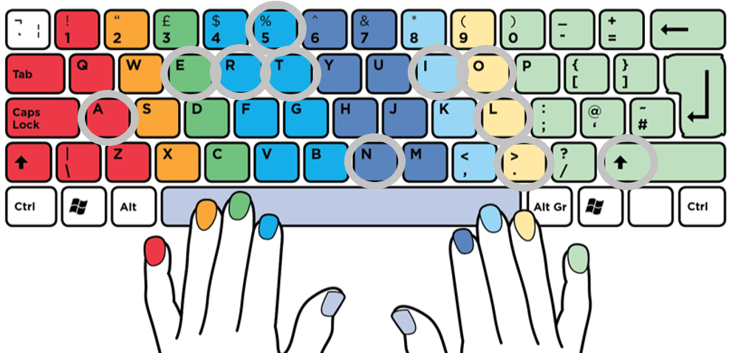

Slide 14
Step-Wise Selection
Performed stepwise for the known dataset and used 28 variables.
Applied stepwise for the unknown dataset and used those variables in the known dataset.
For unknown we used 13 variables out of 33 predictors.

Slide 15
Models
The models we tried:
LDA(Linear Discriminant Analysis)
Random Forest
Bagging
Boosting
SVM with 3 kernels (Radial, Polynomial and Linear)
Model Based Clustering

Slide 16
Predictions
We calculated two different accuracy rates:
The first rate is with observation to observation .(where we predicted the subject for each observation and checked it against the true subject of that observation.)
The second rate we gave the name grouping accuracy.

Slide 17
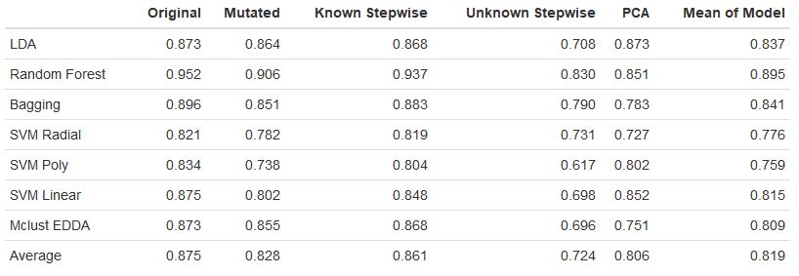
Results Table
QDA Worked for PCA with .3361 Accuracy
Boosting and Mclust 1 both performed at around .6 accuracy for all subsets.
Notes:
Original – All the variables
Mutated – Omitted the H variables and made 5 new variables of H
Known Stepwise – Regrssion – DD.IE UD.IE H.5, UD.Shift.R.o, H.O.H.Da (6 variables)
Unknown Stepwise – Kept Variables - rep,H.period,DD.t.i,UD.t.i,UD.i.e,DD.Shift.r.o,H.o,UD.o.a,H.a,DD.n.l,H.l,DD.l.Return, UD.l.Return

Slide 18
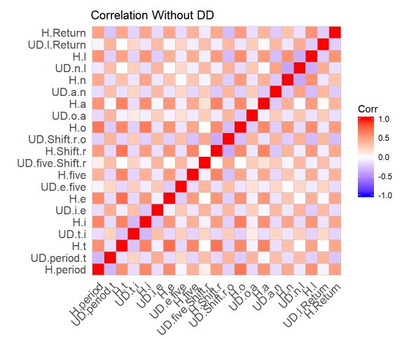
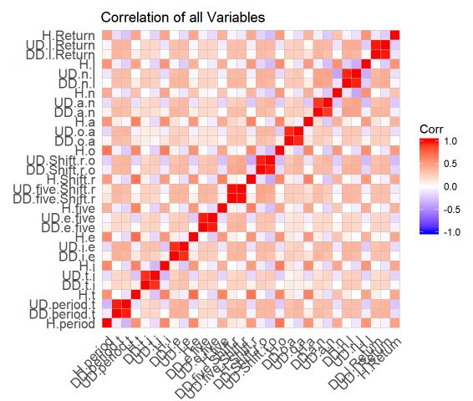
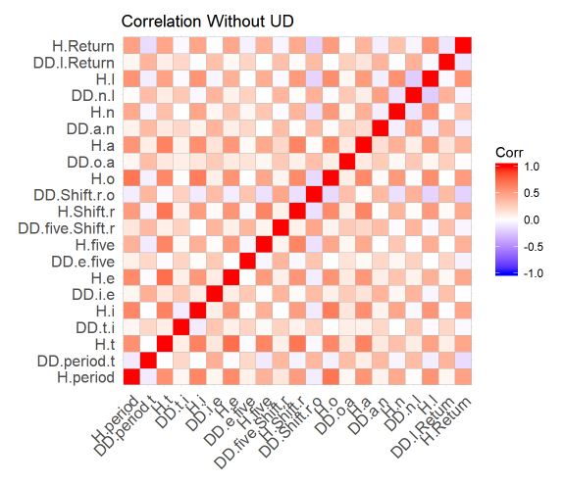
Collinearity
Notes:
UD ad DD are correlated.
Then we plotted the Correaltion of DD and saw that there are –ve coorelation exists between the H and UD
But that –ve coorelation is reduced in the DD and H variables

Slide 19
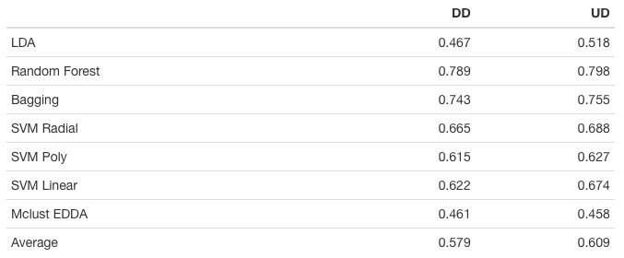
DD Vs. UD
Notes:
This is done to see which one to keep
So we found UD was better and removed DD
Bagging boost strap the model and add up
RF is also a type of Bagging the model
Uncorrelated
will take only few predictors and in building up the model
MClust Model based clustering

Slide 20
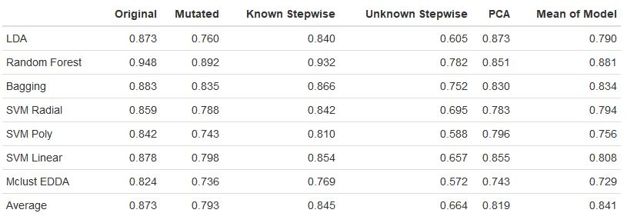
Results Table (Without DD)
Boosting and Mclust 1 again both performed around .6 accuracy for all subsets.
Notes:
SVM Other Kernel - nonlinear patterns can be found at a reasonablecomputational cost.
The complexity increased

Slide 21
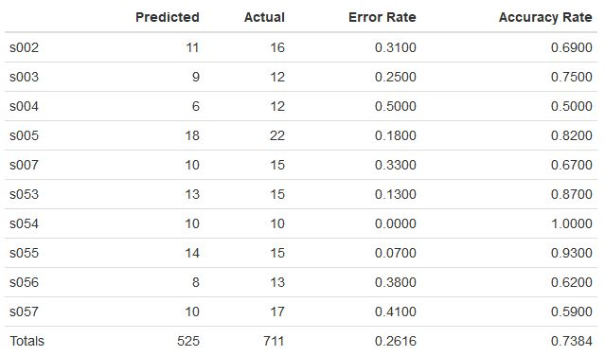
Grouping Accuracy Rate
Mutated with DD results for grouping with SVM Polynomial model which had a grouping accuracy of 1.
Notes:
These Results are from Mutated Poly
We are interested in this one cuz it did not gave the 100%
So we have analyzed the group

Slide 22
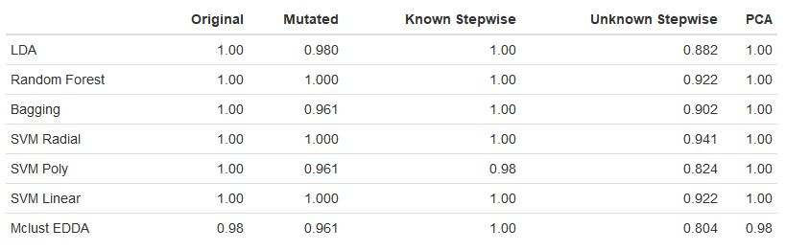
Grouping Results
Grouping results for subsets without DD.
Notes:
This grouping is without the DD
Reason: Grouping and predicting in each (are all out of 51)(test)

Slide 23
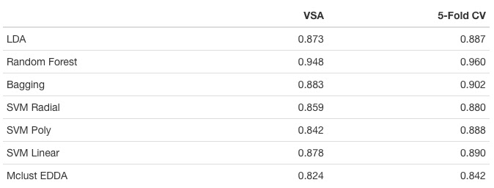
5-Fold CV
Notes:
Which is from the best subset

Slide 24
Conclusion
Best split : 60:40
Best model : Random Forest
Best subset : Original data without DD
Best model accuracy:
5-fold CV : 0.96
60:40 split: 0.948
Grouping: 1.00

Slide 25
References
Mutation variable selection
https://github.com/cjcohan/Springboard/tree/master/Capstone

Slide 26


